Slide 1

Barber_shop
RNS INSTITUTE OF TECHNOLOGY
BENGALURU - 98
DEPARTMENT OF INFORMATION SCIENCE & ENGINEERING
Presentation on Internship
Sushmitha N J
USN: 1RN19IS409
ENMAZ Engineering Services Pvt. Ltd.
Internal Guide
Mrs. Kusuma R
Asst. Prof, Dept of ISE, RNSIT
External Guide
Mr. Akshay BR
Co-Founder, EMMAZ, Bengaluru, Karnataka

Slide 2
AGENDA
Abstract
About the Company
Introduction
Requirements
System Design
Detailed Design
Implementation
Testing
Conclusion and Future Enhancements
References
Q & A

Slide 3
ABSTRACT
Searching out for the best barber shop or hair salons within our vicinity is a very tiresome task ,and also visiting barbershop without prior appointment booking can keep us waiting in a queue .
To solve this issue we can develop an android and web based barbershop application.
it is difficult to develop applications for both iOS and Android with in less time.
To overcome this, Google introduced a new framework called Flutter.
So with this reactive framework we have developed responsive Flutter application for a user friendly interface for booking appointment.
Flutter is highly customizable, which allows it to build apps that are brand-centric, or with the look and feel of native Android and iOS apps from a single code base

Slide 4
About the Company
Enmaz has a simple yet robust solution that helps any Industry / Factory digitise their workflow in no time. The products offered will help in remote monitoring, controlling and also analysing any machine parameter or process
This company has reliable hardware that its time tested, high quality, designed, developed and manufactured in India with 18 months of replacement warranty.
Innovative software that is easy to use, highly scalable and cloud-based IoT platform.
Dynamic dashboard, Reports, Remote control, Email & SMS alerts.
Their competitive cost is that their cloud hosting starts as low as INR 1299 per month and Hardware prices can compete with best in the industry

Slide 5
INTRODUCTION
Gone are the days when barber shop business was something only people took up to keep themselves busy in their free time.
This web based or ios and android based application provide appointment scheduling functionality.
Both the barbershop owners & users can access the application by registering themselves on the app by submitting the login details.
The users can view the available services, based on which they can book an appointment as per their desired time & date.
Before booking particular service user can review the rating for barbers available in barber shop.

Slide 6
Requirements
Hardware Requirements
CPU: Intel i5 8th gen and above
RAM: 8 GB
HDD: 40 GB
Software Requirements
Operating System: Windows 10 and above
Front-end Design: Visual Studio Code / Android Studio Emulator / Chrome
Front-end Language: Dart

Slide 7
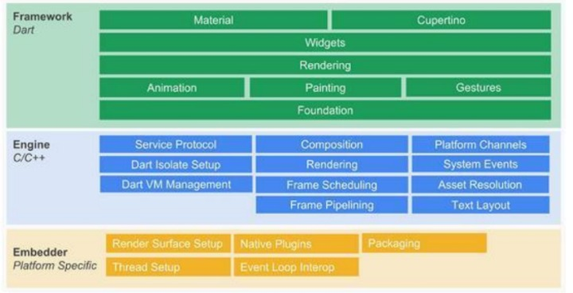
System Design
Architecture
The Flutter framework is organized into a series of layers, with each layer building upon the previous layer.

Slide 8
Continuation of Architecture:
Embedder: Operating system adaptation layer to realize rendering Surface settings, thread settings, etc.
Engine◦: Realize functions such as Flutter rendering engine, text layout, event processing, and Dart runtime. Including Skia graphics drawing library, Dart VM, Text, etc., among which Skia and Text provide the ability to call the underlying rendering and typesetting for the upper layer interface.
Framework: It is a UI SDK implemented with Dart. From top to bottom, it includes two major style component libraries, basic component libraries, graphics drawing, gesture recognition, animation and other functions.

Slide 9
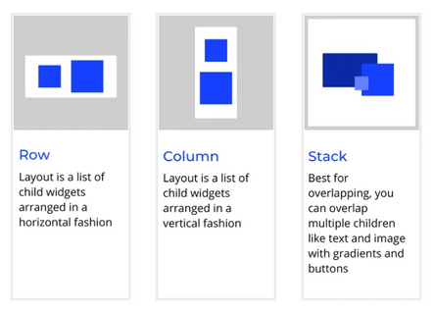
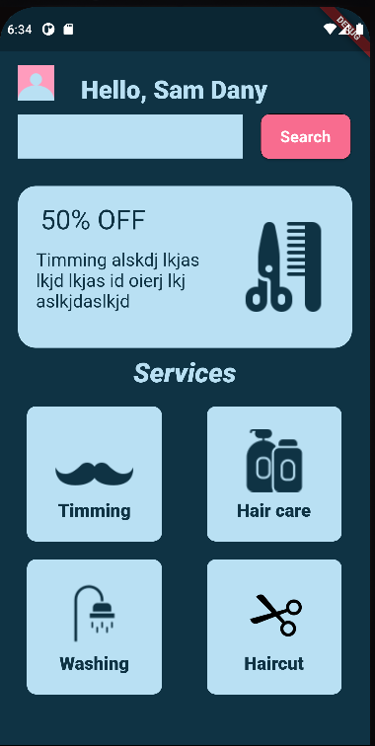
Detailed Design
Design details on Flutter widgets : Row, Column, Stack

Slide 10

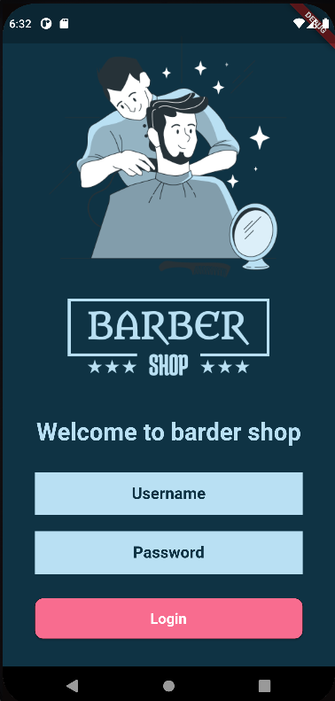
Detailed Design
Design details – Scaffold/Forms/ElevatedButtons
Wireframe design
UI design

Slide 11
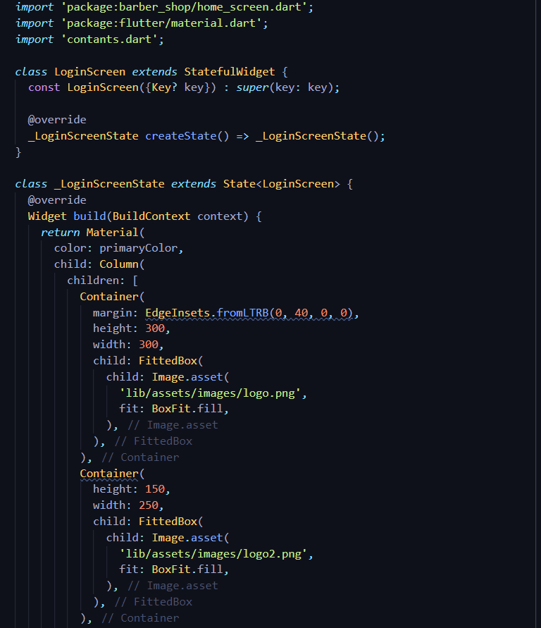
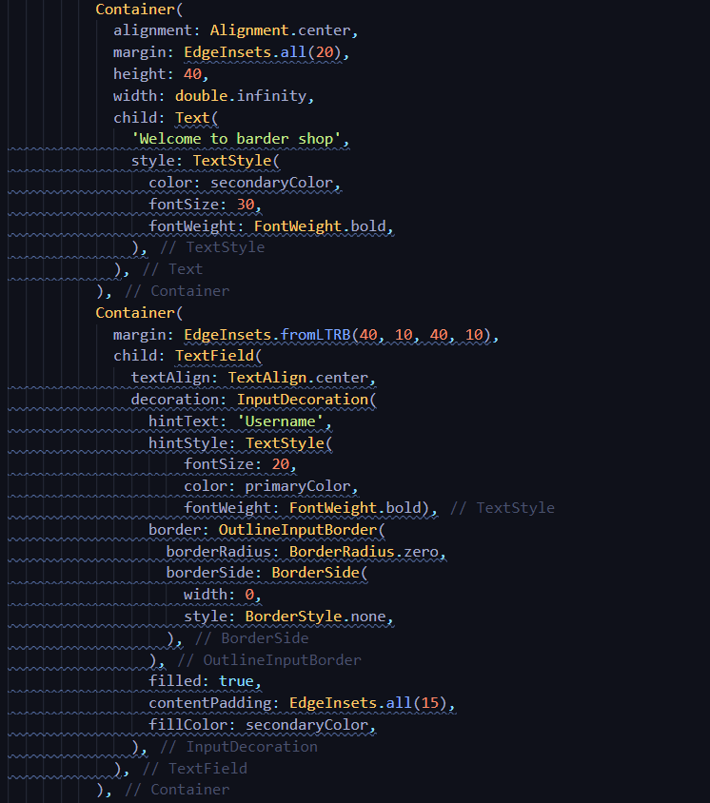
Implementation
Login Screen

Slide 12
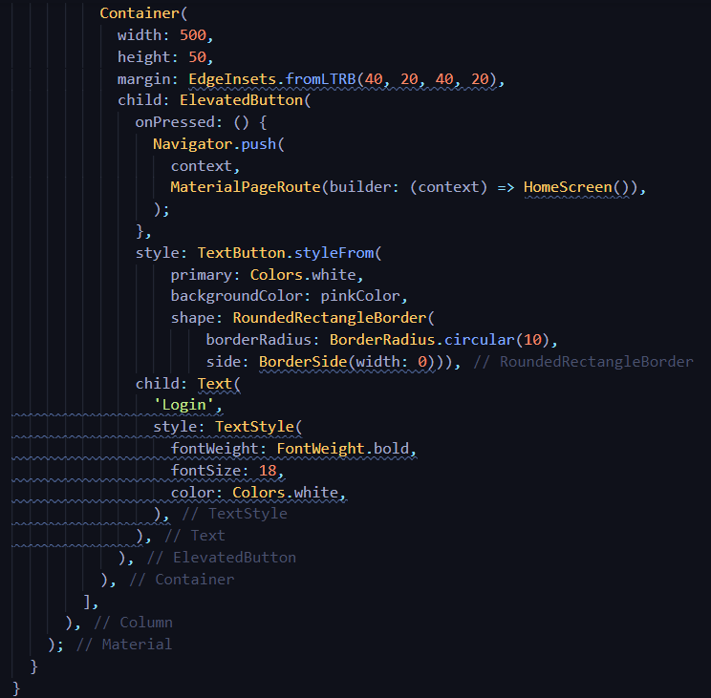
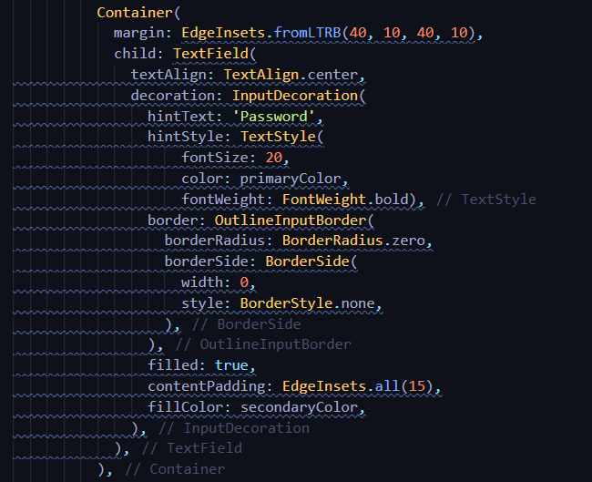
Implementation
Cont. of Login screen

Slide 13
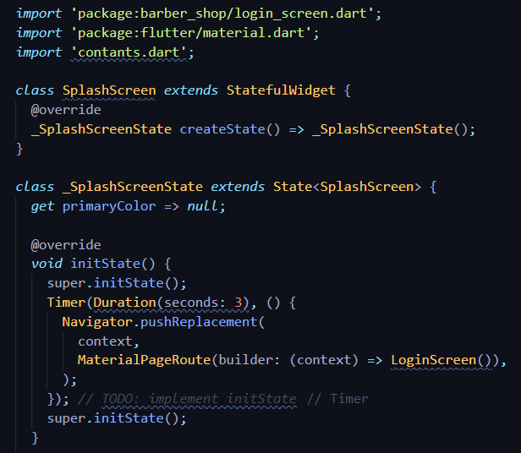
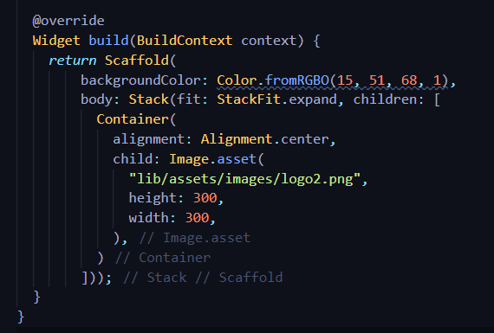
Implementation
Splash screen

Slide 14
CONCLUSIONS
Online booking is a faster, easier way for clients as well as Barber shop to take work and manage it according to their availability.
The app allows user to find different types of services such as Trimming, haircare ,washing and haircut and also barber names with rating and available date / time is displayed in appointments ,this will help people to select the services.
Flutter framework will surely enable a lot of new developers to develop high performances and features-full mobile application

Slide 15
Future Enhancements
• Secured payment system with various payment methods.
• Implementing the email or message service as the remainder of appointment
• Implementing the same features for more the one Barber shop.
• And also reschedule of date and time can be implemented.

Slide 16
REFERENCES
[1] www.stackoverflow.com
[2] www.w3schools.com
[3] www.github.com
[4] www.codecademy.com
[5] www.geeksforgeeks.org
[6] www.dribble.com
[7] www.medium.com

Slide 17
Question and Answer

Slide 18
THANK YOU

